Slide 1

Exam AZ-305: Designing Azure Infrastructure Solutions Crash Course
Tim Warner

Slide 2

Tim Warner
Senior Content Developer w/ Microsoft
Based in Nashville, TN, US
MCT, Former MVP
Twitter: @TechTrainerTim
Badge: TechTrainerTim.com

Slide 3
Day 1 of 2 Agenda
Introduction
Design identity, governance, and monitoring solutions (25-30%)
Design data storage solutions (20-25%)

Slide 4
Day 2 of 2 Agenda
Content catch-up
Design business continuity solutions (15-20%)
Design infrastructure solutions (30-35%)
Exam AZ-305 strategy

Slide 5
Course Materials
timw.info/az305

Slide 6
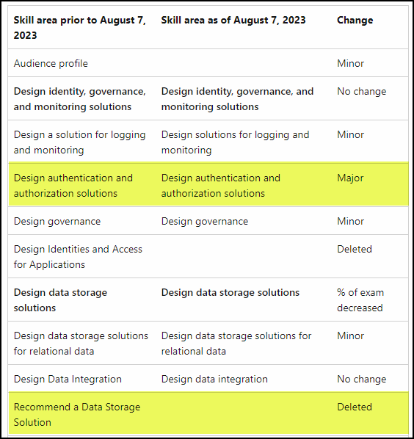
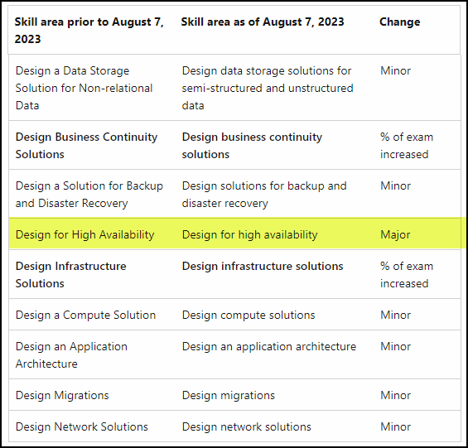
Exam AZ-305 Latest OD Changes

Slide 7
Level-Setting
We'll learn by doing – majority demo
Visual, case study approach
This is an expert certification, so we move quickly and assume intermediate-level Azure skills
10-minute break at midpoint
I’m here to answer your questions – take advantage of this!
Use the Q&A panel

Slide 8
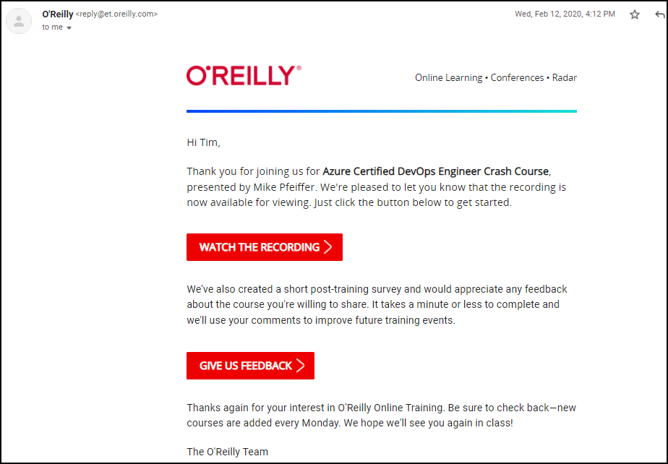
Session Recordings

Slide 9

Session Recordings

Slide 10

Session Recordings

Slide 11

Session Recordings

Slide 12


Mobile Browser: learning.oreilly.com

Slide 13



O'Reilly Mobile App

Slide 14
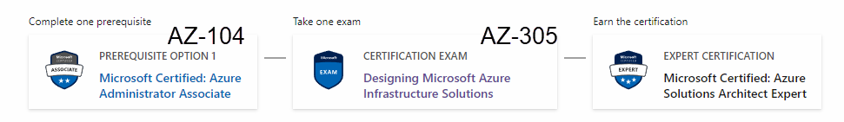
Azure Solutions Architect Expert
One-year validity

Slide 15

Tim's Certification Study Model

Slide 16
Critical Microsoft Docs Sites
Cloud Adoption Framework (CAF)
Well-Architected Framework (WAF)
Azure Architecture Center (AAC)

Slide 17
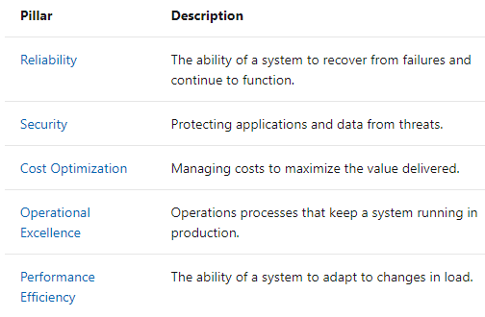
Microsoft Well-Architected Framework

Slide 18
Thank you!
Course materials: timw.info/az305
Twitter: @TechTrainerTim
Work: timw.info/ps
Web: TechTrainerTim.com

Slide 19

Azure Monitor

Slide 20

Log Analytics

Slide 21

Sentinel

Slide 22

Tenant vs. Subscription

Slide 23

Hybrid Identity

Slide 24

Azure AD B2C

Slide 25
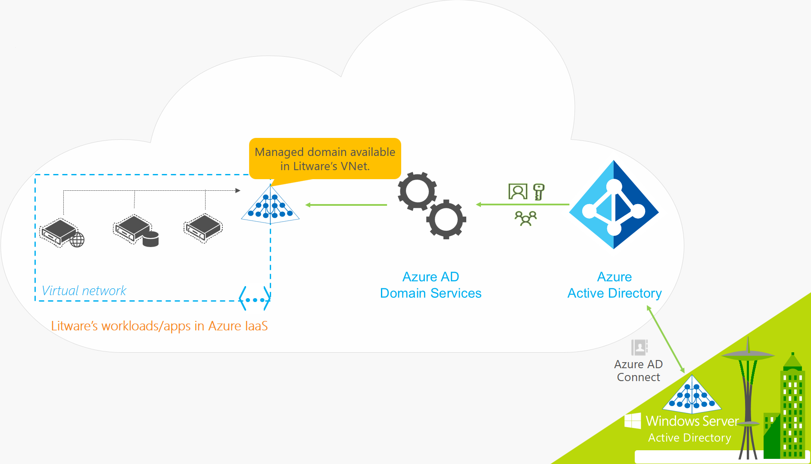
Azure AD Domain Services

Slide 26

Pass-through Authentication

Slide 27

Seamless Single Sign-on

Slide 28

Azure Management Scopes
/ Tenant Root

Slide 29
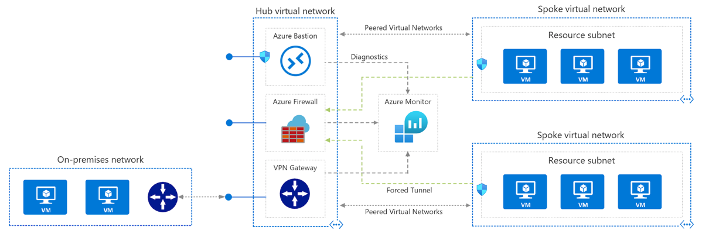
Azure VNet Hub-Spoke

Slide 30
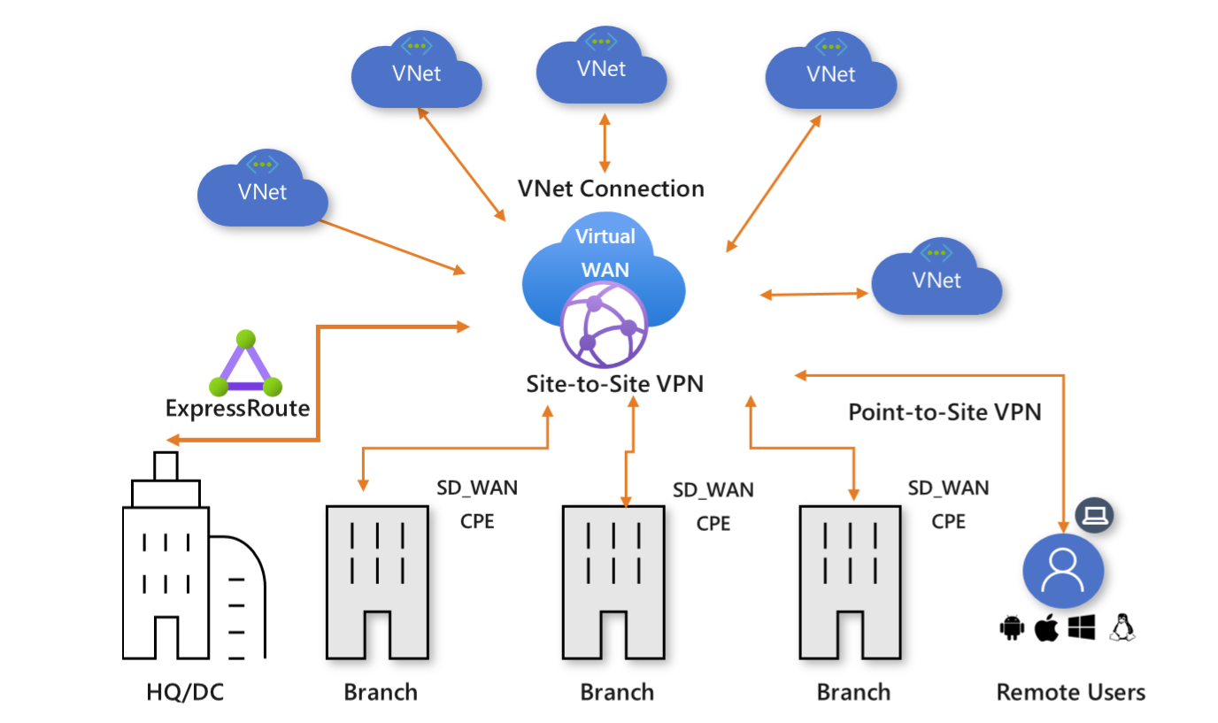
Azure Virtual WAN

Slide 31
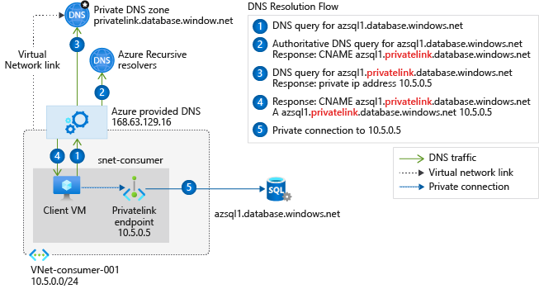
Private Link DNS Configuration

Slide 32

Azure Backup

Slide 33
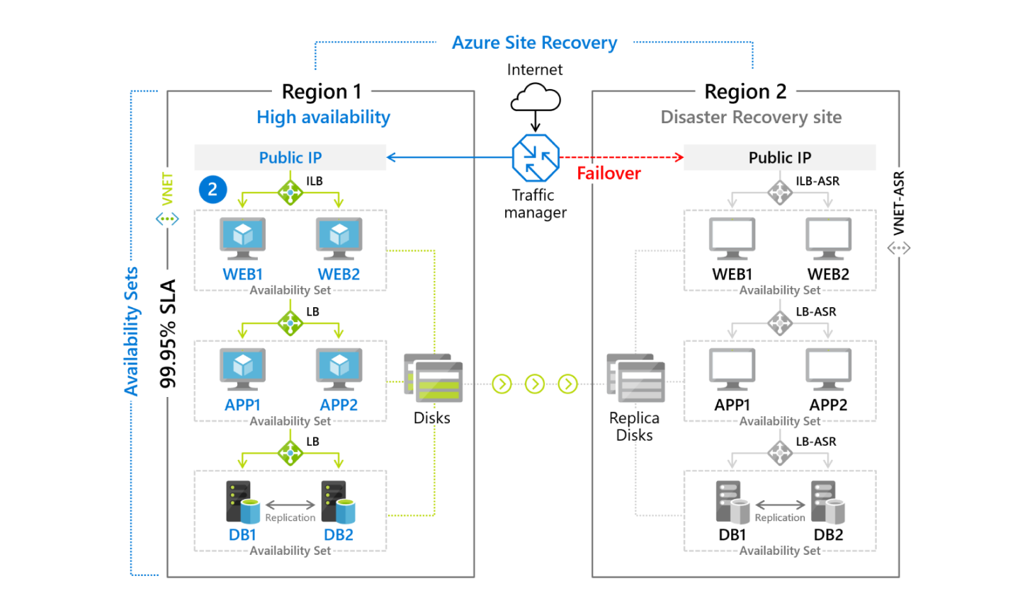
Azure Site Recovery

Slide 34

VM Scale Sets

Slide 35
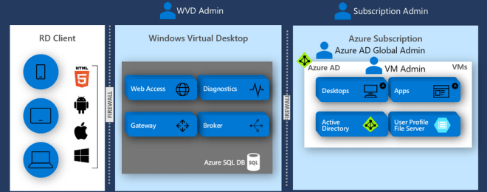
Windows Virtual Desktop (WVD)
timw.info/travis

Slide 36

Availability Set

Slide 37

Availability Zone

Slide 38

VM Networking

Slide 39

Load Balancing

Slide 40

VNet Peering

Slide 41

Hybrid Networking

Slide 42

Network Virtual Appliance

Slide 43

Azure Load Balancer

Slide 44

Application Gateway

Slide 45

Traffic Manager

Slide 46

Front Door Service

Slide 47


Docker Container Lifecycle
https://timw.info/3635f

Slide 48
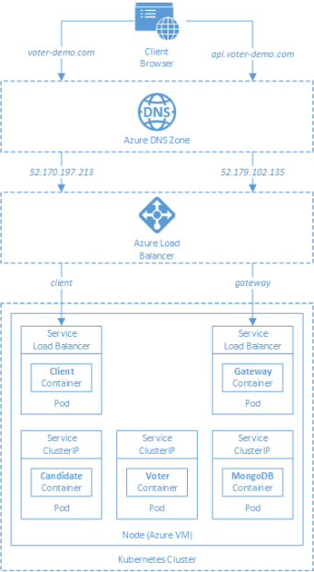
AKS

Slide 49
Azure Backup

Slide 50

Azure Site Recovery

Slide 51
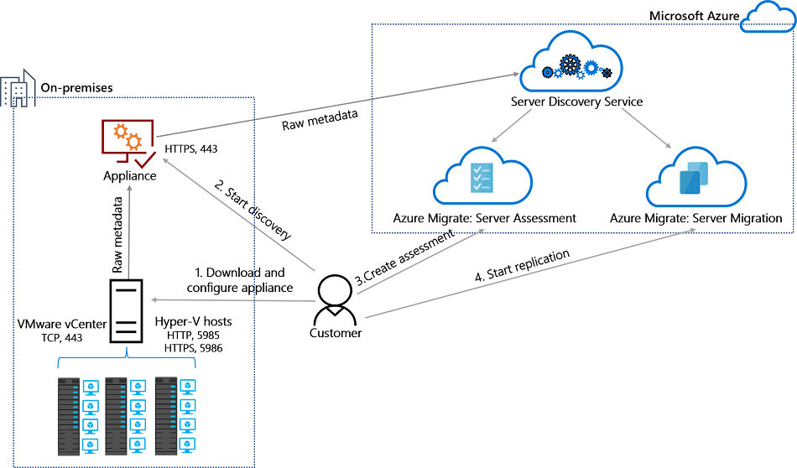
Azure Migrate

Slide 52
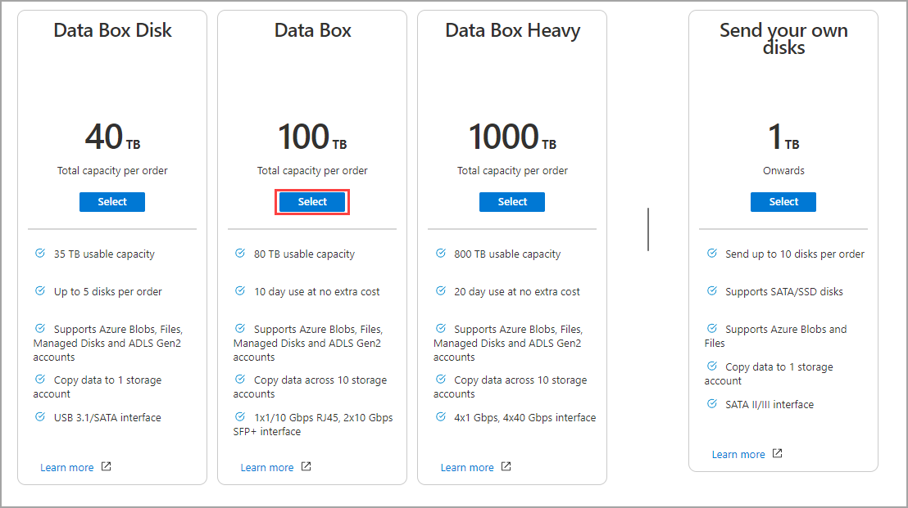
Azure Data Box

Slide 53

Data Pipelines

Slide 54
Storage Account Replication
1
3
3
2
LRS
ZRS

Slide 55
Storage Account Replication
3
3
GRS/RA-GRS

Slide 56
Storage Account Replication
1
3
1
3
2
2
GZRS – RA/GZRS

Slide 57

Always Encrypted

Slide 58
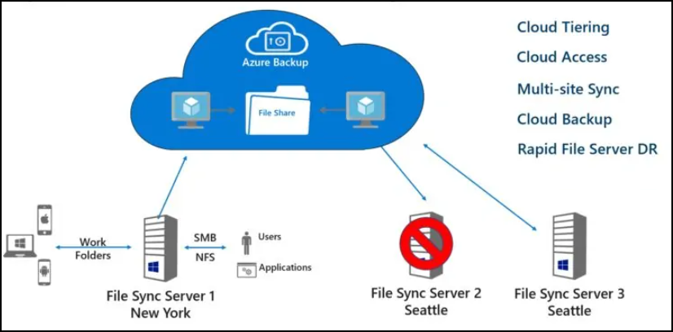
Azure File Sync

Slide 59
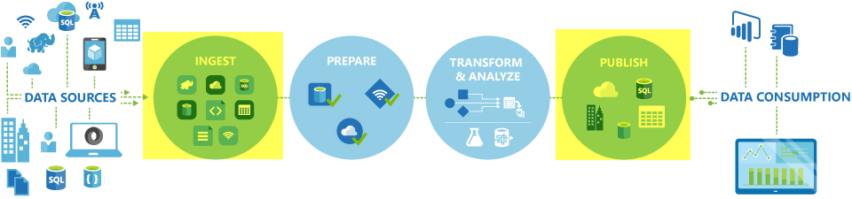
Azure Data Factory

Slide 60

Event Architecture

Slide 61

Event Architecture

Slide 62
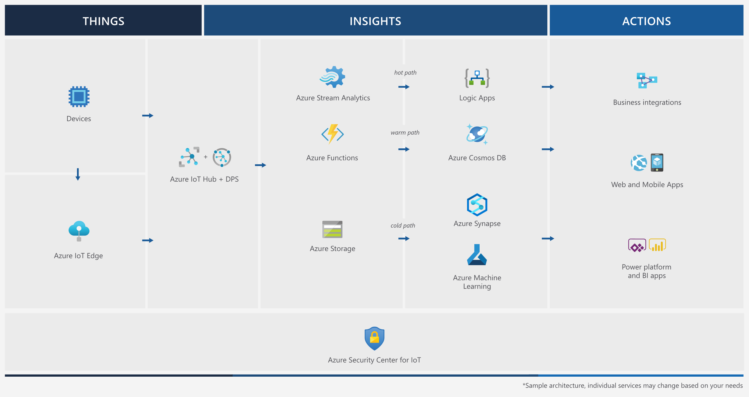
Event Architecture

Slide 63
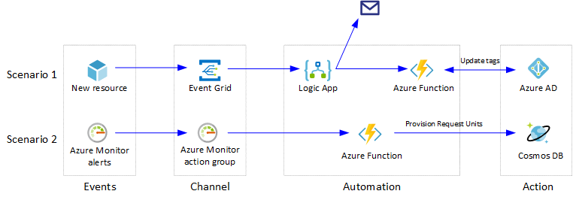
Event Architecture

Slide 64
Exam AZ-304 Item Types

Slide 65

Multiple Choice

Slide 66
Repeated Scenario
You need to move an Azure VM to another hardware host.
Solution: You redeploy the VM.
Does this solution meet the goal?
Yes
No

Slide 67

Select and Place

Slide 68

Build List and Reorder

Slide 69

Active Screen/Fill in the Blank

Slide 70

Case Study

Slide 71






Performance-Based Lab

Slide 72
Microsoft Online Testing

Slide 73
Microsoft Online Testing Process
timw.info/online

Slide 74

Microsoft Online Testing Process

Slide 75

Microsoft Online Testing Process

Slide 76

Microsoft Online Testing Process

Slide 77

Microsoft Online Testing Process

Slide 78

Microsoft Online Testing Process

Slide 79

Microsoft Online Testing Process

Slide 80

Microsoft Online Testing Process

Slide 81

Assemble the Required Materials
Webcam, microphone, and speakers
No headset
Wired or Wi-Fi Internet connection
No VPN
No tethering
Supported OS
Windows, macOS
Smartphone and ID
Mouse-based monitor
No touchscreen

Slide 82
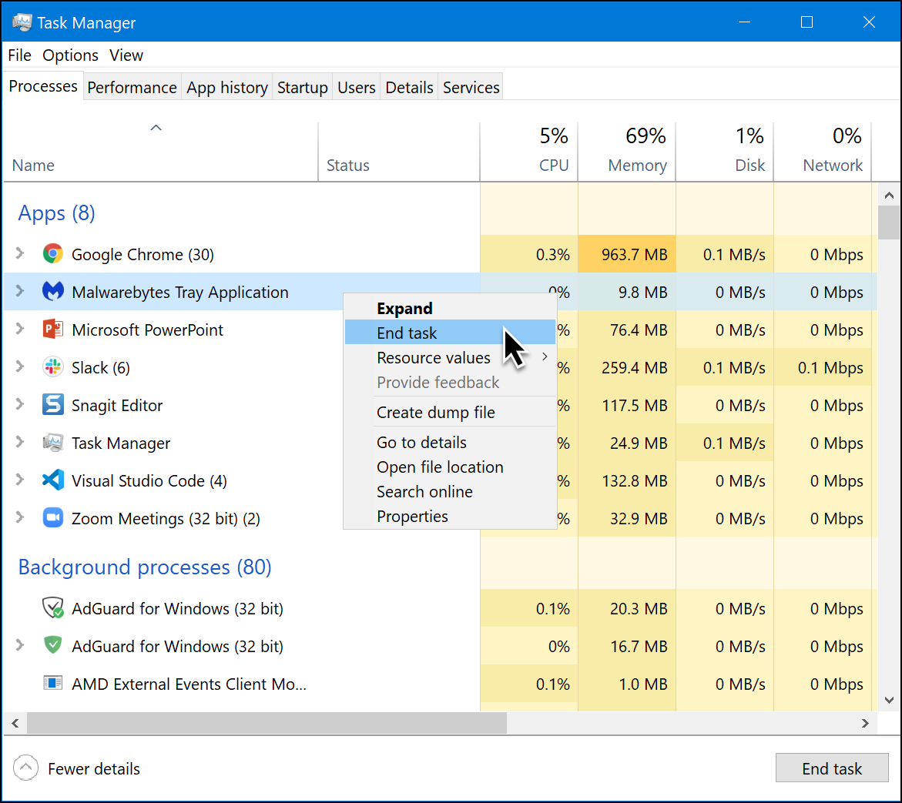
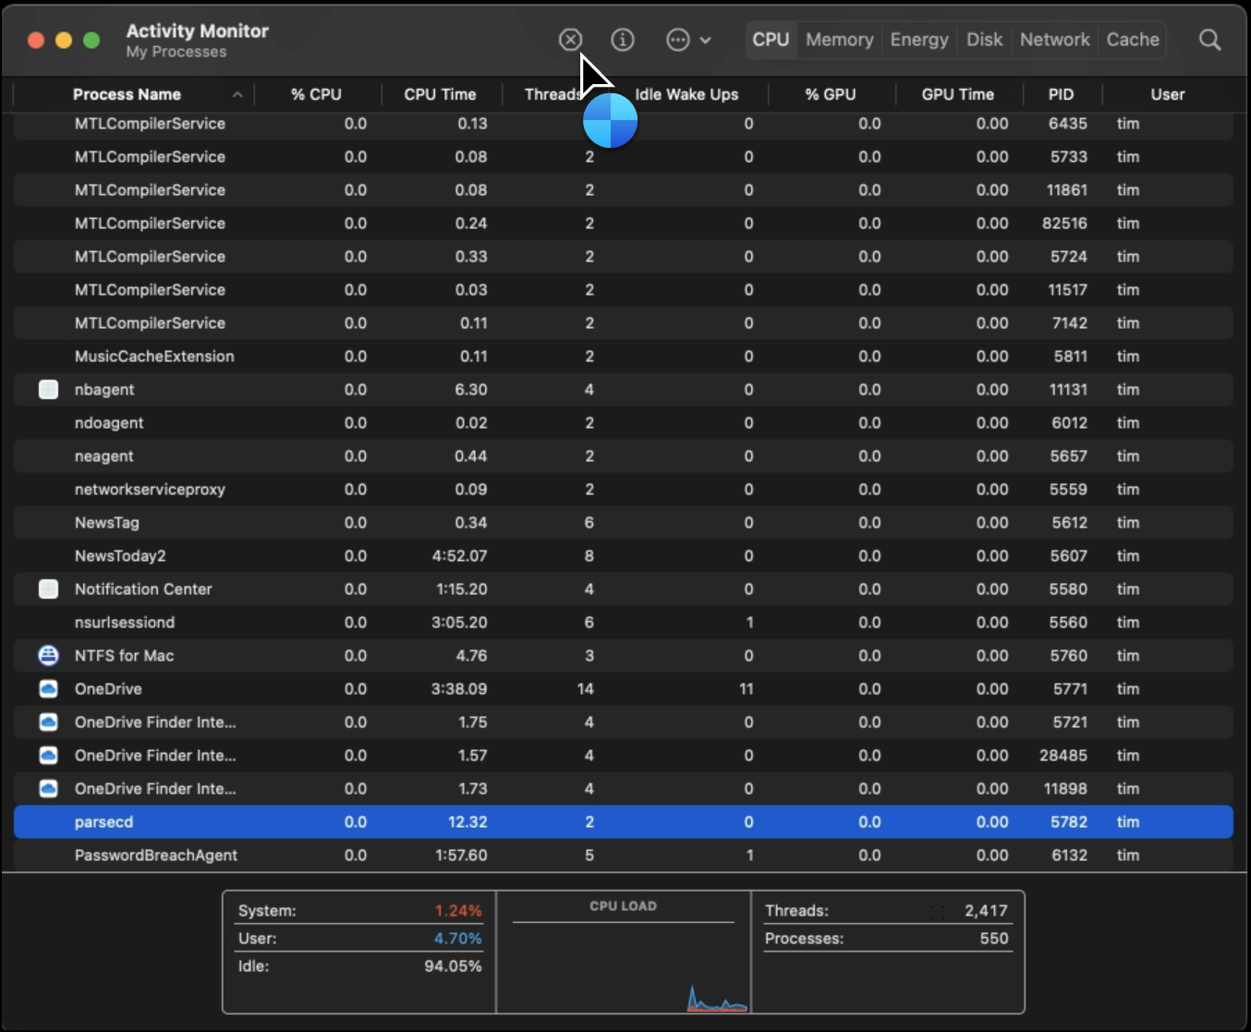
Prepare Your Testing Workstation
Windows
macOS

Slide 83
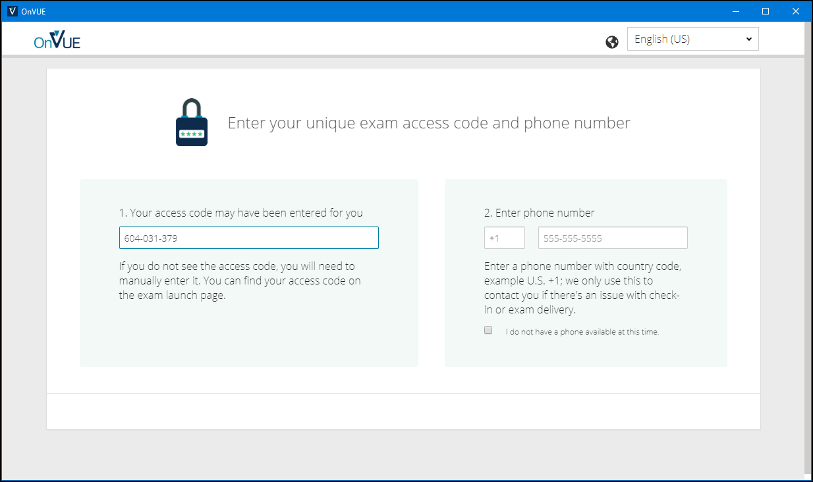
Pearson OnVUE Check-In

Slide 84
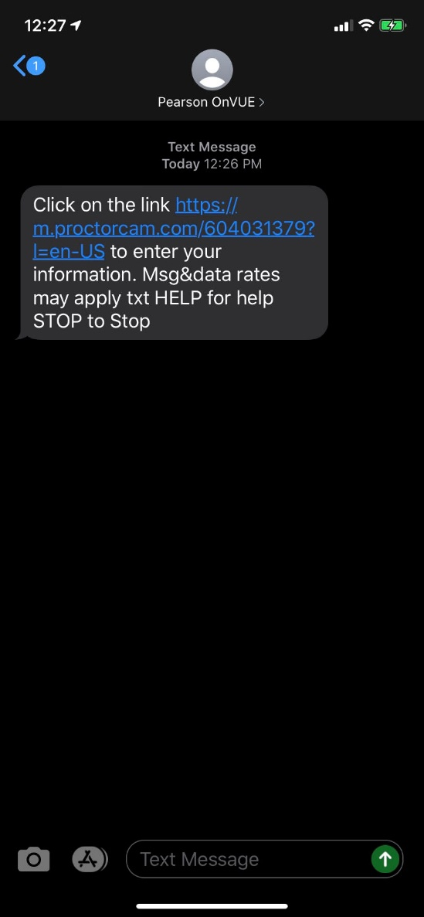
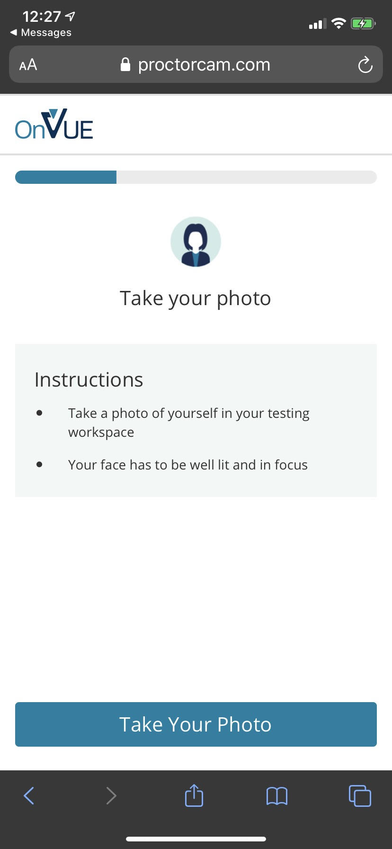
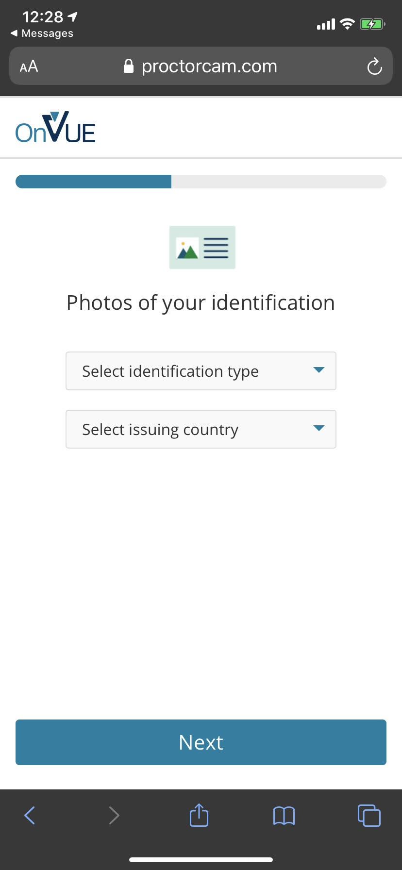
Pearson OnVUE Check-In

Slide 85
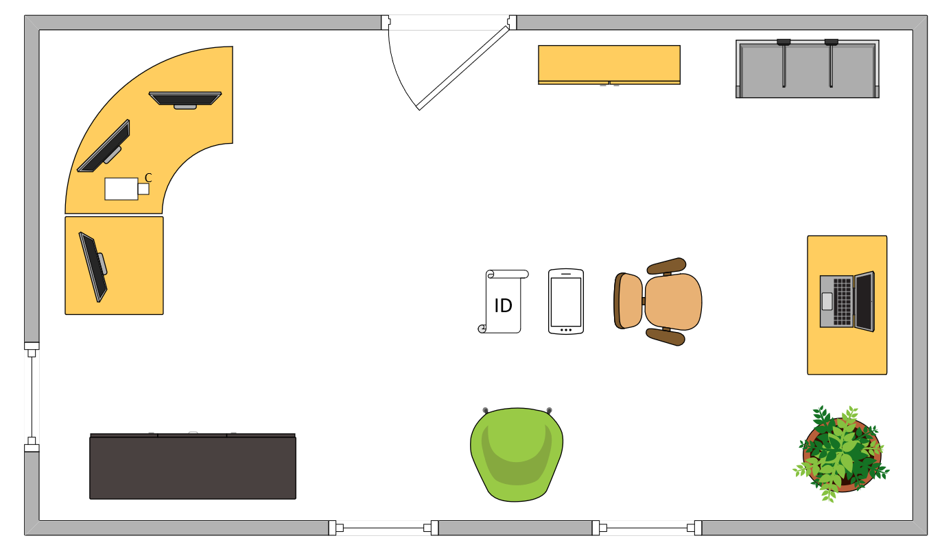
Tim’s Ideal Testing Room
No interruptions or bio breaks
Cover monitors and cameras
Pull back for environment photos
Clear table with laptop

Slide 86

Congratulations!

Slide 87
AZ-305 Exam Strategy
Focus your skills accordingly:
60 percent Azure portal
20 percent Azure PowerShell
10 percent Azure CLI
10 percent KQL
Expect performance-based labs, but be thankful if you don't see 'em

